Slide 1
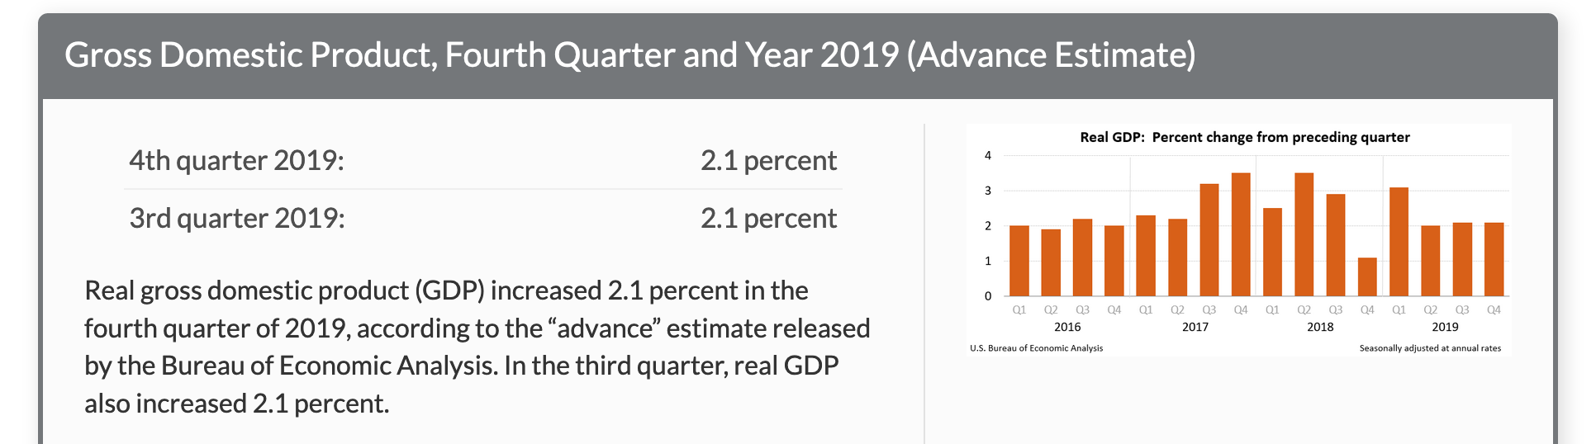
GDP, Fourth Quarter and Year 2019 (01/30/20)
https://www.bea.gov/data/gdp/gross-domestic-product

Slide 2
Ch. 27
The Basic Tools of Finance

Slide 3
Look for the answers to these questions:
What is “present value”? How can we use it to compare sums of money from different times?
Why are people risk averse? How can risk-averse people use insurance and diversification to manage risk?
What determines the value of an asset? What is the “efficient markets hypothesis”? Why is beating the market nearly impossible?

Slide 4
Introduction
The financial system
Coordinates saving and investment
Participants in the financial system
Make decisions regarding the allocation of resources over time and the handling of risk
Finance
Studies such decision making

Slide 5
Present Value: The Time Value of Money
The present value of a future sum:
The amount that would be needed today to yield that future sum at prevailing interest rates
The future value of a sum:
The amount the sum will be worth at a given future date, when allowed to earn interest at the prevailing rate
Notes:
To compare sums from different times, we use the concept of present value.

Slide 6
EXAMPLE 1: A Simple Deposit
Deposit $100 in the bank at 5% interest. What is the future value (FV) of this amount?
Present value, PV = $100
Interest rate, r = 0.05
In N years, future value FV = PV(1 + r)^{N}
In three years, FV=$100(1 + 0.05)³=$115.76
In two years, FV=$100(1 + 0.05)² = $110.25
In one year, FV = $100(1 + 0.05) = $105.00
So, PV = FV / (1 + r)^{N}

Slide 7
Present Value
General formula for discounting:
r, interest rate
X, amount to be received in N years (future value)
Present value = X / (1+r)^{N}
Discounting
Find present value for a future sum of money

Slide 8
EXAMPLE 2: Investment Decision
PV = FV / (1 + r)^{N}
Suppose r = 0.06. Should General Motors spend $100 million to build a factory that will yield $200 million in ten years?
Solution: need to find present value of $200 million in 10 years:
PV = ($200 million)/(1.06)¹⁰ = $112 million
Since PV > cost of factory, GM should build it.

Slide 9
EXAMPLE 2: Investment Decision
Instead r=0.06, suppose r = 0.09.
Should General Motors spend $100 million to build a factory that will yield $200 million in ten years?
PV = FV / (1 + r)^{N}
Solution: need to find present value of $200 million in 10 years:
PV = ($200 million)/(1.09)¹⁰ = $84 million
Since PV < cost of factory, GM should not build it.
Present value helps explain why investment falls when the interest rate rises.

Slide 10
Active Learning 1 Present value
You are thinking of buying a six-acre lot for $70,000. The lot will be worth $100,000 in five years.
Should you buy the lot if r = 0.05?
Should you buy it if r = 0.10?
Notes:
The lot purchase would be for speculative purposes.

Slide 11
Active Learning 1 Answers
You are thinking of buying a six-acre lot for $70,000. The lot will be worth $100,000 in five years.
Should you buy the lot if r = 0.05?
Should you buy it if r = 0.10?
PV = $100,000/(1.05)⁵ = $78,350. PV of lot > price of lot.
Yes, buy it.
PV = $100,000/(1.1)⁵ = $62,090. PV of lot < price of lot.
No, do not buy it.

Slide 12
Present value of a future sum falls when the interest rate rises.
Present value helps explain why investment falls when the interest rate rises.

Slide 13
Compounding
Compounding:
The accumulation of a sum of money where the interest earned on the sum earns additional interest
Because of compounding
Small differences in interest rates lead to big differences over time.

Slide 14
Compounding
Example: Buy $1000 worth of Microsoft stock, hold for 30 years.
If rate of return = 0.08,
FV = 1000(1+0.08)³⁰=1000(10.063) =$10,063
If rate of return = 0.10,
FV =1000 (1+0.10)³⁰=1000(17.450) = $17,450
Thus, a 2% increase in the rate of return leads to over $7000 of additional interest earned over the 30 years.
Notes:
Without compounding, a 2% rate-of-return difference over 30 years would lead to a 60% difference in FV.
But because of the magic of compounding, the difference here is 74% (because $17,450 is 74% bigger than $10,063).

Slide 15
The Rule of 70
The Rule of 70:
If a variable grows at a rate of x percent per year, that variable will double in about 70/x years.
Example:
If interest rate is 5%, a deposit will double in about 14 years.
If interest rate is 7%, a deposit will double in about 10 years.
(70/5 =14)
(70/10 =10)
Notes:
The FYI box in the textbook, ‘The Magic of Compounding and the Rule of 70’ has more details about compounding and the Rule of 70.

Slide 16
Risk Aversion
Most people are risk averse—they dislike uncertainty.
Example: You are offered the following gamble. Toss a fair coin:
If heads, win $1000; If tails, you lose $1000
Should you take this gamble?
If you are risk averse, the pain of losing $1000 would exceed the pleasure of winning $1000.
Since both outcomes are equally likely, you should not take this gamble.

Slide 17
The Utility Function
0
Utility is a subjective measure of well-being that depends on wealth.
As wealth rises, the curve becomes flatter due to diminishing marginal utility: the more wealth a person has, the less extra utility he would get from an extra dollar.
Utility
Current utility
Wealth
Current wealth
Notes:
17

Slide 18
The Utility Function and Risk Aversion
0
Utility
Utility gain from winning $1000
Utility loss from losing $1000
Because of diminishing marginal utility, a $1000 loss reduces utility more than a $1000 gain increases it.
Wealth
–1000
+1000
Notes:
18

Slide 19
Managing Risk With Insurance
How insurance works:
A person facing a risk pays a fee to the insurance company, which in return accepts part or all of the risk.
Insurance
Allows risks to be pooled, and can make risk averse people better off:
E.g., it is easier for 10,000 people to each bear 1/10,000 of the risk of a house burning down than for one person to bear entire risk alone.

Slide 20
Two Problems in Insurance Markets
Adverse selection:
A high-risk person benefits more from insurance, so is more likely to purchase it.
Moral hazard:
People with insurance have less incentive to avoid risky behavior.

Slide 21
Two Problems in Insurance Markets
Insurance companies
Cannot fully guard against these problems (adverse selection & moral hazard), so they must charge higher prices.
As a result, low-risk people sometimes forego insurance and lose the benefits of risk-pooling.

Slide 22
Active Learning 2 Adverse selection or moral hazard?
Identify whether each of the following is an example of adverse selection or moral hazard.
Joe begins smoking in bed after buying fire insurance.
Both of Susan’s parents lost their teeth to gum disease, so Susan buys dental insurance.
When Mary parks her Corvette convertible, she doesn’t bother putting the top up, because her insurance covers theft of any items left in the car.
Notes:
Just a quick check to see if students understand the difference between moral hazard and adverse selection.

Slide 23
Measuring Risk
Standard deviation
A statistic that measures a variable’s volatility—how likely it is to fluctuate.
Used to measure the risk of an asset
The higher the standard deviation of the asset’s return, the greater the risk

Slide 24
Reducing Risk Through Diversification
Diversification
Reduces risk by replacing a single risk with a large number of smaller, unrelated risks.
A diversified portfolio
Assets whose returns are not strongly related
Some assets will realize high returns, others low returns.
The high and low returns average out, so the portfolio is likely to earn an intermediate return more consistently than any of the assets it contains.

Slide 25
Reducing Risk Through Diversification
Firm-specific risk
Affects only a single company
Market risk
Affects all companies in the stock market
Diversification
Can eliminate firm-specific risk
Cannot eliminate market risk

Slide 26
Reducing Risk Through Diversification
0
Increasing the number of stocks reduces firm-specific risk.
50
40
Standard dev of portfolio return
30
20
But market risk remains.
10
0
0
10
20
30
40
# of stocks in portfolio
Notes:
26
Even a portfolio with 40 stocks still has risk because you just can’t eliminate market risk through diversification.

Slide 27
Tradeoff Between Risk and Return
Tradeoff:
Riskier assets pay a higher return, on average, to compensate for the extra risk of holding them.
E.g., over the past 200 years, average real return:
On stocks, 8% (riskier asserts)
On short-term government bonds, 3%.
Notes:
DATA

Slide 28
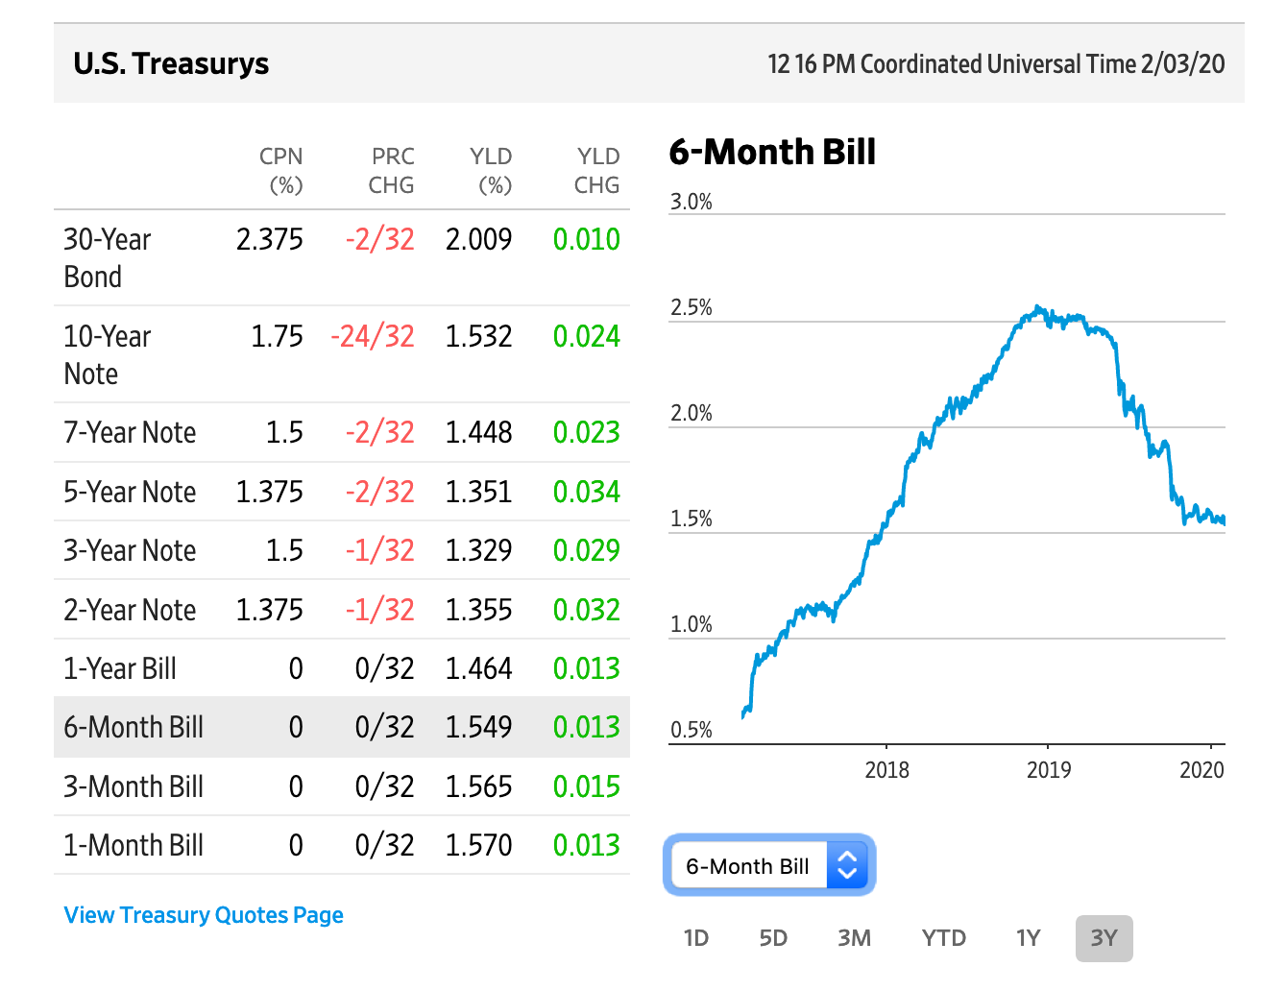
US Treasurys (WSJ 02/03/20)
https://www.wsj.com/market-data/bonds?mod=md_home_overview_bonds_main

Slide 29
Tradeoff Between Risk and Return
Suppose you are dividing your portfolio between two asset classes.
A diversified group of risky stocks:
average return = 8%, standard dev. = 20%
A safe asset:
return = 3%, standard dev. = 0%
The risk and return on the portfolio depends on the percentage of each asset class in the portfolio…

Slide 30
Asset Valuation
When deciding whether to buy a company’s stock
You compare the price of the shares to the value of the company.
Stocks are:
Undervalued if Price < Value
Overvalued if Price > Value
Fairly valued if Price = Value
Notes:
It’s easy to look up the price. But how does one determine the stock’s value?

Slide 31
Active Learning 3 Valuing a share of stock
If you buy a share of AT&T stock today,
you will be able to sell it in 3 years for $30.
you will receive a $1 dividend at the end of each of those 3 years.
If the prevailing interest rate is 10%, what is the value of a share of AT&T stock today?
(Dividends ---Payments made by a company to owners of the company’s stock. A dividend is paid per share of stock.)
(Prevailing interest rate --- The average current interest rate in the economy)

Slide 32
Active Learning 3
amount you will receive
when you will receive it
present value of the amount
$1
in 1 year
$1/(1.1) = $ .91
$1
in 2 years
$1/(1.1)² = $ .83
$1
in 3 years
$1/(1.1)³ = $ .75
$30
in 3 years
$30/(1.1)³ = $22.54
The value of a share of AT&T stock equals the sum of the numbers in the last column: $25.03

Slide 33
Asset Valuation
Value of a share
= PV of any dividends the stock will pay + PV of the price you get when you sell the share
Problem:
When you buy the share, you don’t know what future dividends or prices will be.
Fundamental analysis (one way to value a stock)
The study of a company’s accounting statements and future prospects to determine its value

Slide 34
Active Learning 4 Show of hands survey
You have a brokerage account with Merrill Lynch. Your broker calls you with a hot tip about a stock: new information suggests that the company will be highly profitable.
Should you buy stock in the company?
Yes
No
Not until you read the prospectus.

Slide 35
Active Learning 4 Show of hands survey
What’s a prospectus?
Prospectus is a formal document that is required by and filed with the Securities and Exchange Commission (SEC) that provides details about an investment offering for sale to the public.

Slide 36
Asset Valuation
Use fundamental analysis to pick a stock
Do all the necessary research yourself
Rely on the advice of Wall Street analysts
Buy a mutual fund
A manager conducts fundamental analysis and makes the decision for you

Slide 37
Asset Valuation: EMH
Efficient Markets Hypothesis (EMH):
The theory that each asset price reflects all publicly available information about the value of the asset
Three implications of EMH:
Stock market is informationally efficient:
Each stock price rationally reflects all available information about the value of the company.

Slide 38
Efficient Markets Hypothesis (EMH)
Stock prices follow a random walk:
A stock price only changes in response to new information (“news”) about the company’s value. News cannot be predicted, so stock price movements should be impossible to predict.
It is impossible to systematically beat the market.
By the time the news reaches you, mutual fund managers will have already acted on it.

Slide 39
According to the efficient markets hypothesis, financial markets process available information rationally, so a stock price always equals the best estimate of the value of the underlying business.
Some economists question the efficient markets hypothesis, however, and believe that irrational psychological factors also influence asset prices.

Slide 40
Asset Valuation
Use fundamental analysis to pick a stock
Do all the necessary research yourself
Rely on the advice of Wall Street analysts
Buy a mutual fund or buy a diverse portfolio.

Slide 41
Asset Valuation Index Funds vs. Managed Funds
An index fund
A mutual fund that buys all the stocks in a given stock index.
An actively managed mutual fund
Aims to buy only the best stocks.
Have higher expenses than index funds
EMH implies that returns on actively managed funds do not consistently exceed the returns on index funds.

Slide 42
Index Funds vs. Managed Funds
0
2001–2006 annualized return
2006 expense ratio
S&P 500 (index fund)
Managed large cap funds
6.2%
5.9
.351
1.020
S&P Mid Cap 400 (index fund)
Managed mid cap funds
10.9
8.1
.535
1.458
S&P Small Cap 600 (index fund)
Managed small cap funds
12.5
10.3
.550
1.272
Notes:
42
The figures for managed funds of a given class (large cap, medium cap, small cap) are asset-weighted averages of all managed funds in the class.
The expense ratio of a fund includes all the expenses (fees) of owning the fund as a percentage of the fund’s value.
The returns in the first column are net of expenses, so it is fair to compare them.
In each asset class, the index fund beats the average of all managed funds in that class.
Source: Standard and Poor’s Indices Versus Active Funds (SPIVA) Scorecard, Fourth Quarter 2006.
http://www.standardandpoors.com
http://www.spiva.standardandpoors.com (http://us.spindices.com/index-finder/)
This source has gobs of great information on this topic. Example: the % of actively managed funds that underperform the S&P 500 at different time horizons. Also, it reports various categories of funds, such as sector funds, international funds, and fixed income funds, and compares their performance at various time horizons to the corresponding index funds.
When looking at newer data, we see negative returns for 2008 and 2011, and the averages of recent years will be negative.

Slide 43
Asset Valuation : Market Irrationality
Many believe that stock price movements are partly psychological:
J.M. Keynes: stock prices driven by “animal spirits,” “irrational waves of pessimism and optimism”
Alan Greenspan: 1990s stock market boom due to “irrational exuberance”

Slide 44
Asset Valuation : Market Irrationality
Bubbles
Occur when speculators buy overvalued assets expecting prices to rise further (Speculative bubbles)

Slide 45
Asset Valuation : Market Irrationality
Debate: frequency and importance of departures from rational pricing
Market irrationality
Movement in stock market is hard to explain - news that alter a rational valuation
Efficient markets hypothesis
Impossible to know the correct/rational valuation of a company
Notes:
The importance of departures from rational pricing is not known.

Slide 46
Conclusion: Basic Tool of Finance
This chapter has introduced some of the basic tools people use when they make financial decisions.
The efficient markets hypothesis teaches that a stock price should reflect the company’s expected future profitability.
Fluctuations in the stock market have important macroeconomic implications, which we will study later in this course.

Slide 47
Summary
Because savings can earn interest, a sum of money today is more valuable than the same sum of money in the future.
The present value of any future sum is the amount that would be needed today, given prevailing interest rates, to produce that future sum.
Because of diminishing marginal utility, most people are risk averse.
Risk-averse people can reduce risk by buying insurance, diversifying their holdings, and choosing a portfolio with lower risk and lower return.

Slide 48
Summary
The value of an asset equals the present value of the cash flows the owner will receive. For a share of stock, these cash flows include the stream of dividends and the final sale price.
According to the efficient markets hypothesis, financial markets process available information rationally, so a stock price always equals the best estimate of the value of the underlying business.
Some economists question the efficient markets hypothesis, however, and believe that irrational psychological factors also influence asset prices.

